Slide 1
Financial Consumer Complaints Analysis
PATRICIA MUGABE
APRIL, 2026

Slide 2
Objective
What was this analysis about?
To analyse consumer complaint data in order to identify key trends, evaluate resolution effectiveness, and uncover drivers of customer dissatisfaction to support service improvement strategies.

Slide 3
Dataset Overview
Total complaints analysed: 75,513
Time period: 2011 – 2020
Data sources:
Complaints data
Products & Issues tables
Key dimensions:
Product, Issue, Channel, State, Response Type

Slide 4
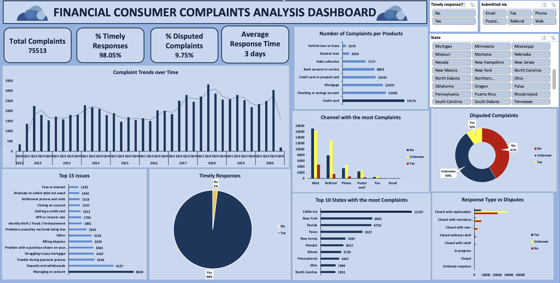
Dashboard Overview
Interactive dashboard built to track complaint trends, resolution performance, and customer satisfaction indicators.

Slide 5
Complaint Trends Over Time
Key Insight:
Complaints increased significantly from 2011 to 2018, peaking at ~11,450
Remain consistently high afterward
So what:
Complaint growth indicates increasing service pressure and potential systemic issues.

Slide 6
High-Complaint Products
Credit Card: 19,176
Checking/Savings: 13,436
Mortgage: 12,470
Insight:
Core financial products drive the majority of complaints.

Slide 7
Top Customer Issues
Top drivers:
Managing account
Deposits & withdrawals
Payment difficulties
Insight:
Most complaints relate to money access, transactions, and account control

Slide 8
Resolution Performance
98% timely responses
~10% disputed complaints
49% dispute status unknown
Critical Insight:
High responsiveness does not translate into customer satisfaction.
Speed ≠ Satisfaction

Slide 9
Response Type vs Disputes
Key Findings:
“Closed with explanation” → highest disputes
“Monetary relief” → lowest disputes
“No relief” → high dissatisfaction
Insight:
Customers respond better to solutions than explanations

Slide 10
Channel Insights
Web: highest complaint volume
Referral: highest dispute proportion
Insight:
Referral complaints are likely escalated and more complex cases.

Slide 11
Key Problem Areas
High complaints in core products (credit cards, accounts)
Transaction-related issues dominate
Over-reliance on explanation-based resolutions
High dispute levels in escalated complaints
Significant data gaps (unknown dispute status)

Slide 12
Recommendations
1. Improve Resolution Quality
Reduce reliance on “explanation-only” responses
Increase use of actionable resolutions (e.g., relief)
2. Focus on High-Risk Issues
Prioritize:
Account management
Deposits & withdrawals
Create specialized resolution teams

Slide 13
3. Strengthen Complaint Handling for Referrals
Treat referral cases as high-priority
Assign experienced agents
4. Improve Data Quality
Make dispute status mandatory
Clean and standardize missing values
5. Enhance Digital Support (Web Channel)
Improve self-service tools
Introduce smarter complaint triaging

Slide 14
Business Impact
If implemented, Cumulus Financial can expect:
Reduced dispute rates
Improved customer satisfaction
Faster and more effective resolutions
Better allocation of support resources
Improving how complaints are resolved will have a greater impact on customer satisfaction than simply responding faster.

Slide 15
THANK YOU!

